Slide 1


Deforestation Detection
(Fire Classification)
Name : Akshita.R
Student ID : STU66a11e7277d6e1721835122
AICTE ID : INTERNSHIP_175040797468551b2636342
College : M. S. Ramaiah University of Applied Sciences

Slide 2

Learning Objectives
Understand deforestation impact and the role of technology in environmental monitoring.
Collect and preprocess spatial or satellite data for ML analysis.
Apply machine learning models (e.g., Random Forest, CNN) to detect deforestation patterns.
Evaluate model performance using accuracy, precision, recall, and F1-score.
Visualize deforestation trends using maps and plots for spatial insights.
GOAL
Source :
www.freepik.com/

Slide 3
Learning Objectives
Goal of the project :
The goal of this project is to develop a machine learning classification model that can accurately predict the type of fire using MODIS fire detection data for India from 2021 to 2023.
This helps in early identification of forest loss, supports environmental conservation efforts, and aids decision-makers in taking timely action to protect ecosystems.
GOAL
Source :
www.freepik.com/

Slide 4
Tools and Technology used
Programming Language : Python
Machine Learning Libraries : scikit-learn , joblib , Numpy
Model Deployment Tools : Streamlit , Gradio
Model Input Data : MODIS Satellite Data
Deployment Environment : Google Collab , Python IDE
GitHub : For documentation
Mathplotlib , Seaborn

Slide 5
Tools and Technology used
Programming Language
Python : Core language for data processing, model development, and deployment.
Machine Learning Libraries :
scikit-learn – Used for building and training the classification model.
joblib – For saving and loading the trained model and scaler efficiently.
NumPy – For handling numerical arrays and input preprocessing.
Model Deployment Tools
Streamlit – Used for building an interactive web app for fire type prediction.
Gradio – Alternative UI framework for creating and deploying the same model with a simple web interface.
Model Input Data
MODIS Satellite Data – Used features like Brightness, Bright_t31, FRP, Scan, Track, and Confidence to classify fire types.
Development Environment
Google Colab – For exploratory data analysis, training, and testing the model.
Python IDE or Terminal – For running and testing the deployed app locally.

Slide 6
Methodology
Data Collection : Collected fire incident data from MODIS satellite readings, including features such as Brightness, Bright_t31, FRP (Fire Radiative Power), Scan, Track, and Confidence level.
Data Preprocessing : Handled missing or inconsistent data. Converted categorical values (like confidence level) into numerical format using mapping. Normalized or standardized features using StandardScaler to ensure uniformity across input variables.
Model Development : Split the data into training and testing sets. Trained multiple classification algorithms (e.g., Random Forest, Decision Tree, etc.). Selected the best-performing model based on evaluation metrics like accuracy, precision, recall, and F1-score.
Model Evaluation : Validated the trained model using the test dataset. Analyzed performance using confusion matrix and classification reports to ensure reliability.
Model Deployment : Serialized the final model and scaler using joblib. Developed a user-friendly interface using Streamlit and Gradio to input feature values and display the predicted fire type in real-time.
Prediction and Interpretation : Mapped model predictions to fire types:
0 → Vegetation Fire
2 → Other Static Land Source
3 → Offshore Fire
Displayed the result clearly to end users for interpretation and decision-making.

Slide 7
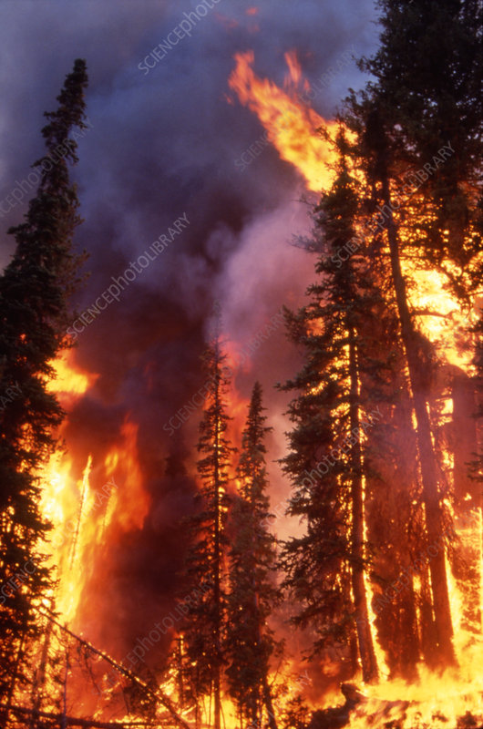
Problem Statement:
Accurate and timely identification of fire types is crucial for environmental monitoring and disaster response. Traditional methods of fire classification are often manual, time-consuming, and prone to human error.
With the availability of satellite data such as MODIS, there is a need to develop an intelligent system that can automatically classify fire types based on measurable parameters like brightness, thermal readings, and confidence levels.
This project aims to build a machine learning-based model that can predict the type of fire—such as vegetation fire, offshore fire, or static land source—using input features derived from satellite observations.
The solution should be scalable, fast, and user-friendly, assisting authorities and researchers in making timely decisions and improving fire management strategies.

Slide 8
Solution:
To address the problem of manual and time-consuming fire classification, this project proposes a machine learning-based solution that automatically predicts the type of fire using satellite-derived data from the MODIS sensor.
The process begins with collecting relevant features such as brightness, thermal band values (Bright_t31), Fire Radiative Power (FRP), scan, track, and confidence level.
These features are preprocessed and scaled to prepare the data for model training.
Various classification algorithms are tested, and the best-performing model—based on accuracy and reliability—is selected.
Algorithms Used:
Decision Tree , Logistic Regression , Random Forest , KNeighbours Classifier , XGBoost Classifier , Gradient Boosting Classifier , Light BGM Classifier , CatBoost Classifier , Neural Network (MLP) Classifier.
Best Algorithm for the model : Random Forest Classifer (97.80 Accuracy) - It gave the highest accuracy and handled non-linear relationships well. Also reduced overfitting due to its ensemble nature.
This trained model is then saved using joblib.
For accessibility, the solution is deployed using Streamlit and Gradio, allowing users to input values and instantly receive a predicted fire type through a user-friendly interface.

Slide 9
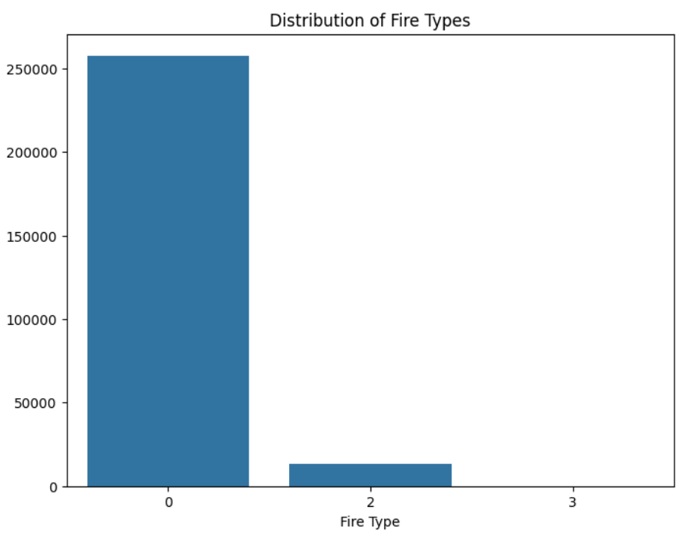
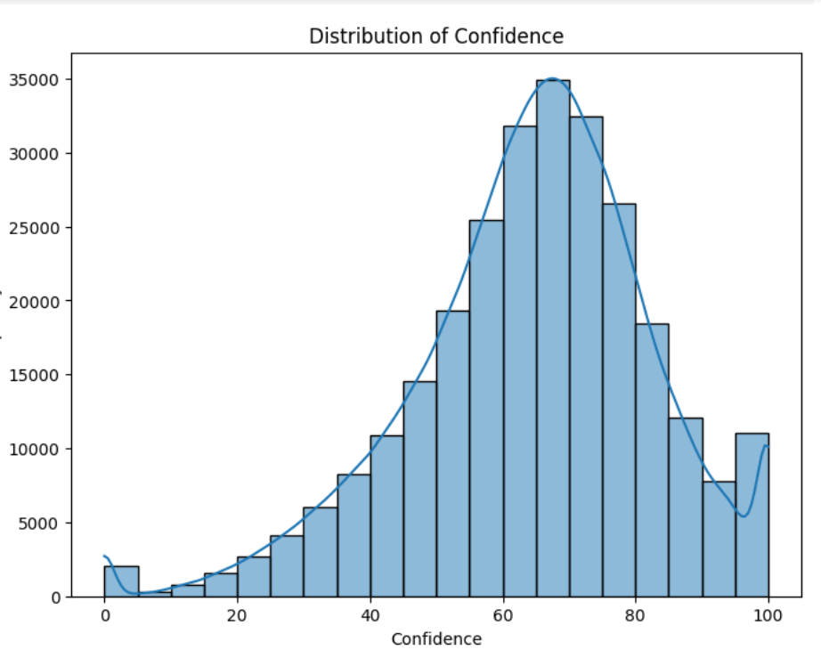
Screenshot of Output:
Plot for Distribution of Fire Types :
Histogram for confidence :

Slide 10
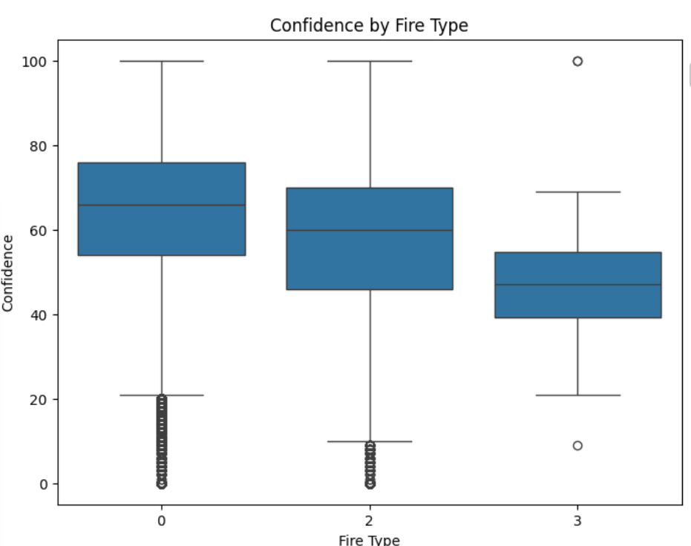
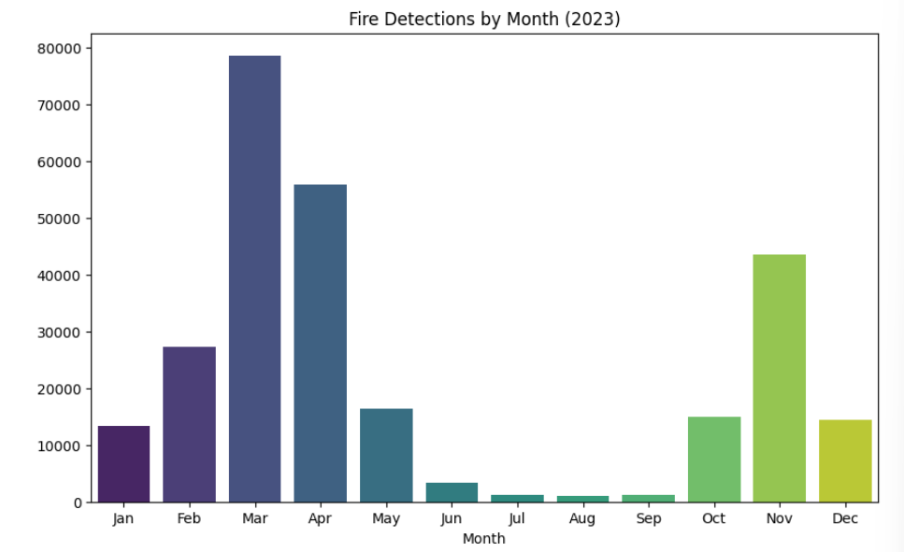
Screenshot of Output:
Plot for Confidence by Fire Type :
Graph for visualizing fire detections over months :

Slide 11
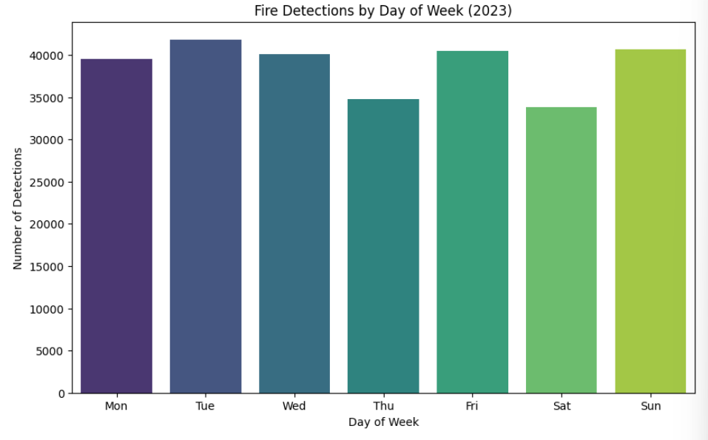
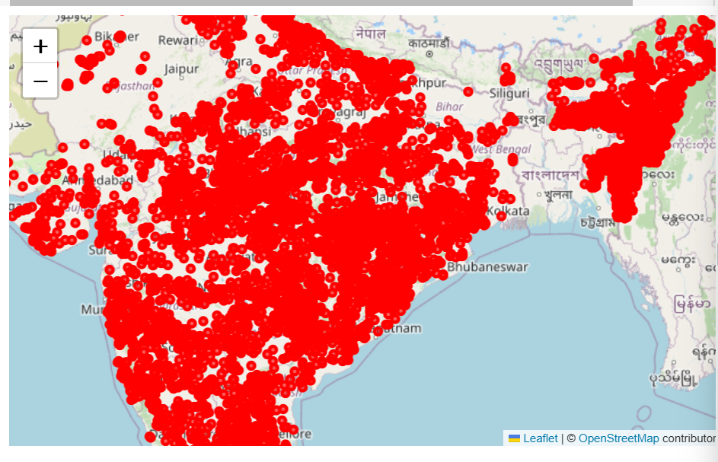
Screenshot of Output:
Graph for visualizing fire detections over day of the week :
Folium visualization of India map :

Slide 12
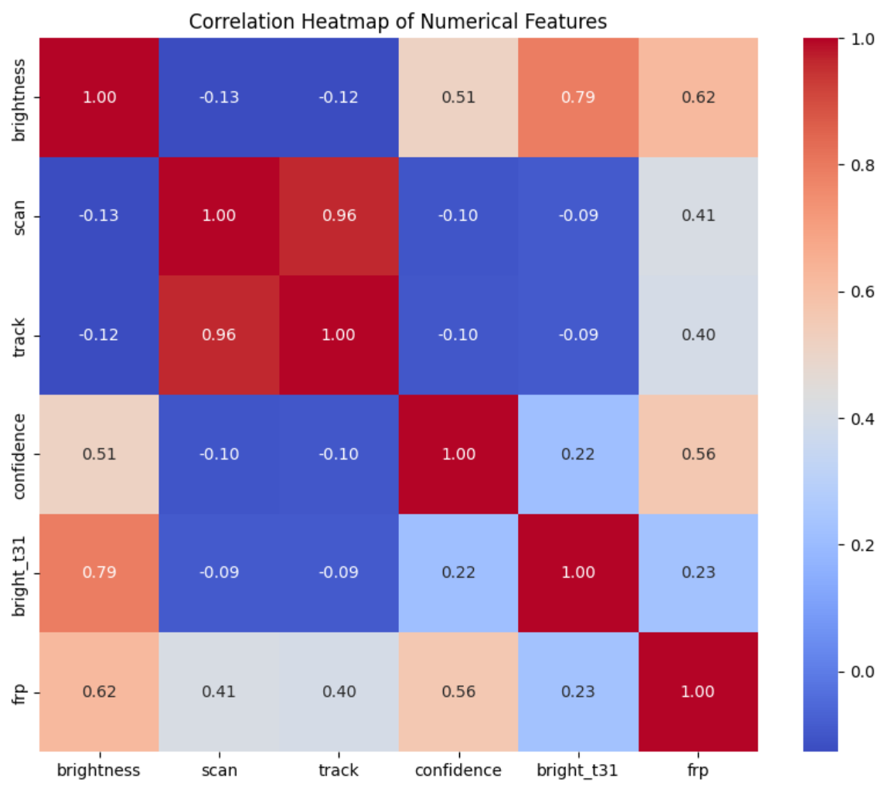
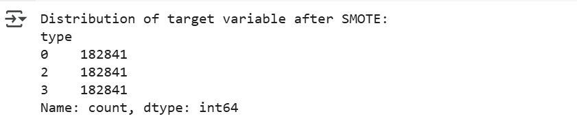
Screenshot of Output:
Correlation Heatmap of numerical features :
SMOTE values :

Slide 13
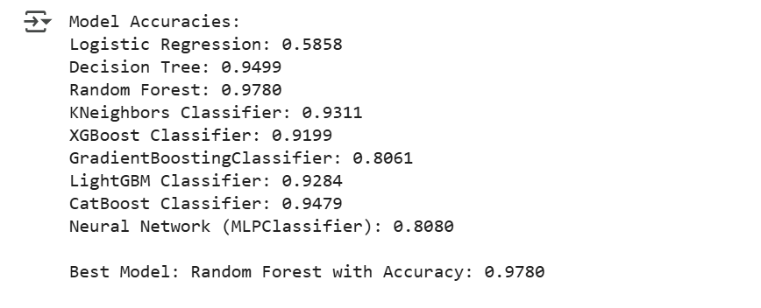
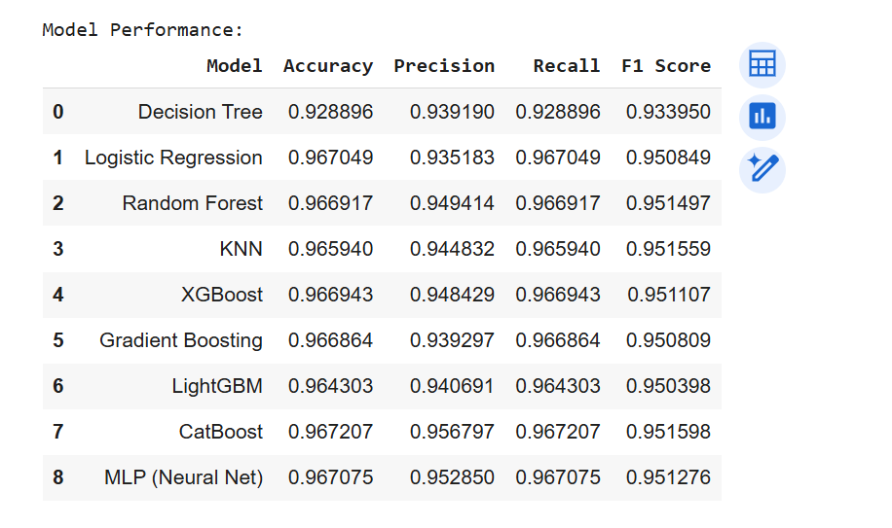
Screenshot of Output:
Best model selection :
Model Performances :

Slide 14
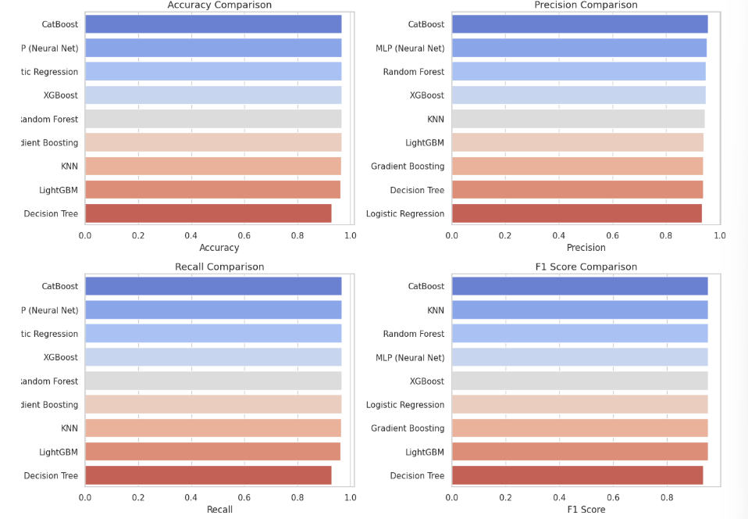
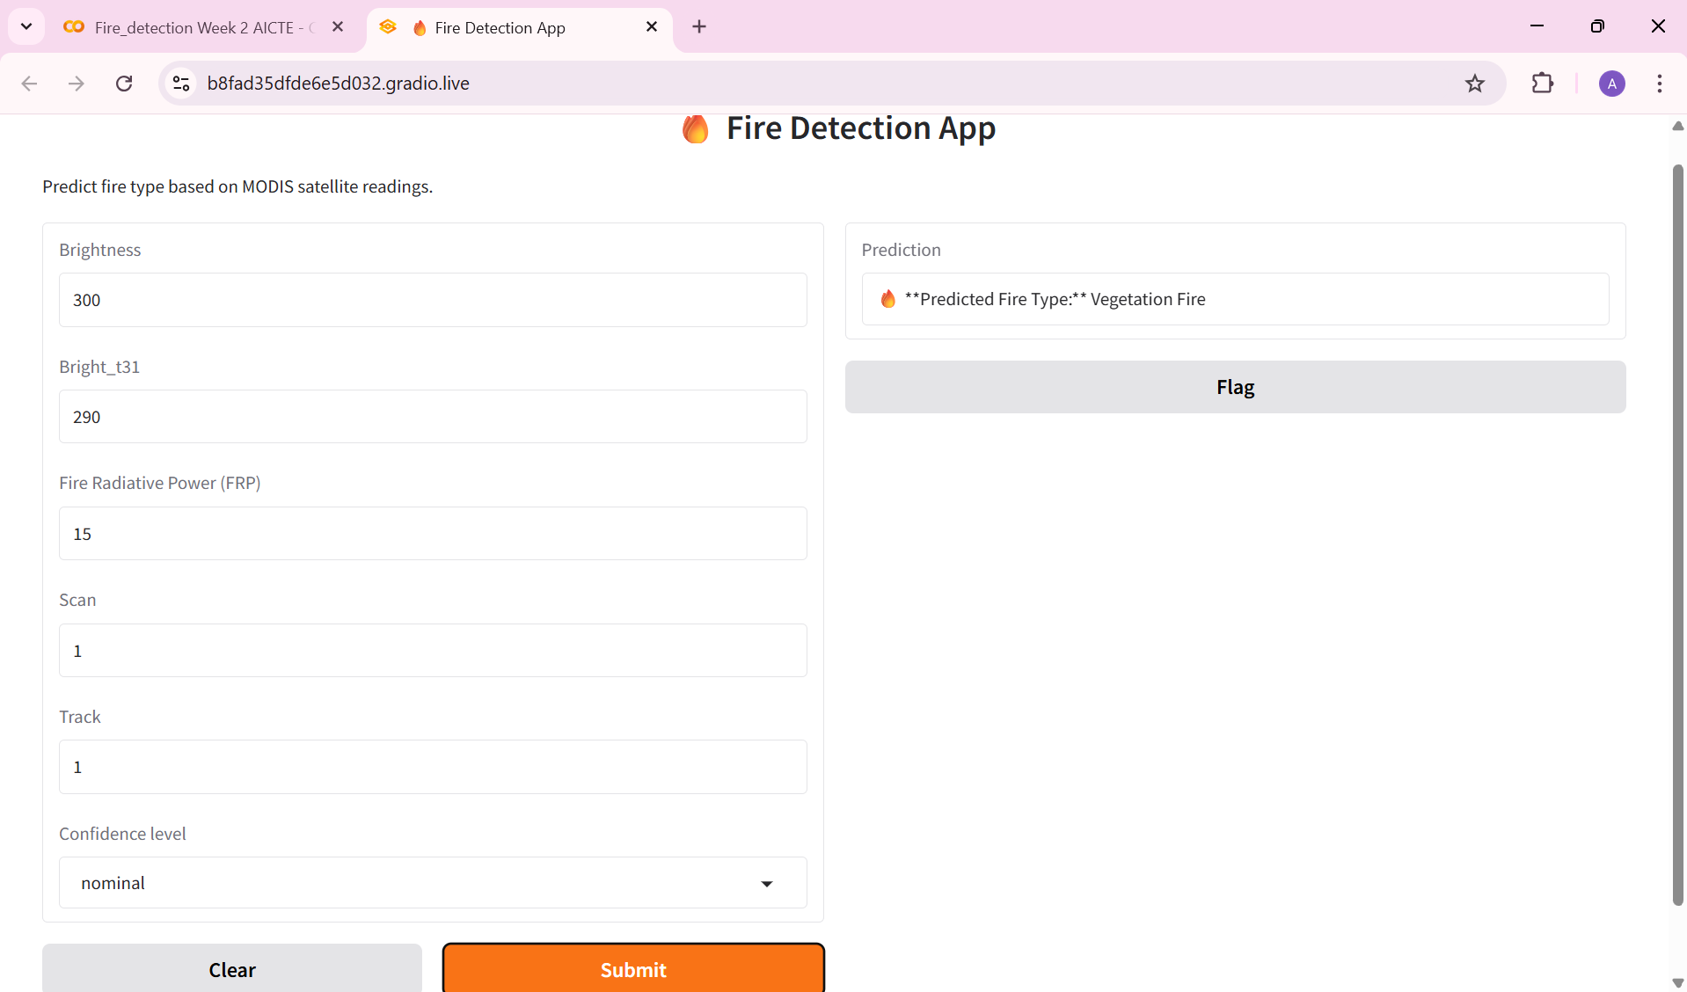
Screenshot of Output:
Model Comparisons :
Model Deployment :

Slide 15
Conclusion:
Developed a machine learning model to classify fire types using MODIS satellite data.
Used key features like brightness, FRP, confidence level, and thermal readings.
Evaluated 9 ML algorithms including Random Forest, XGBoost, CatBoost, and MLP.
This project demonstrates the power of machine learning in solving real-world environmental challenges.
By analyzing satellite-based fire data, an intelligent system was developed to classify different types of fires with high accuracy.
The use of advanced algorithms like Random Forest, XGBoost, CatBoost, and Neural Networks enabled reliable predictions.
Such automated systems can significantly support timely decision-making, improve wildfire response strategies, and contribute to sustainable environmental monitoring.

